Slide 1

Case Studies
Why look at case studies?
deeplearning.ai

Slide 2
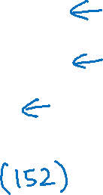
Outline
Classic networks:
LeNet-5
AlexNet
VGG
ResNet
Inception

Slide 3
Case Studies
Classic networks
deeplearning.ai

Slide 4
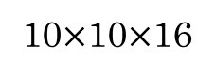

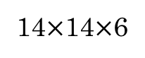

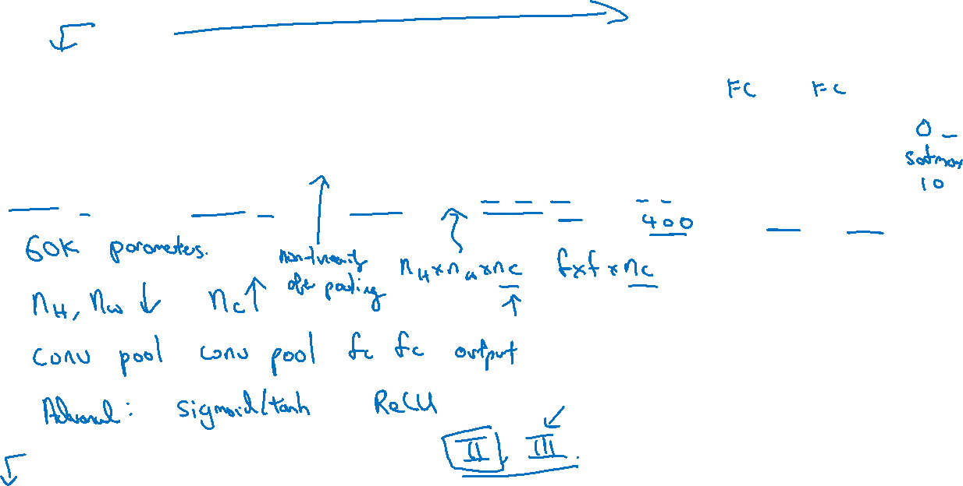
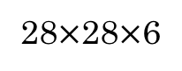
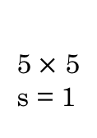
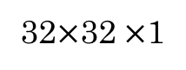
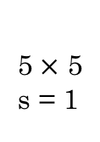
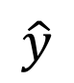
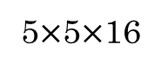
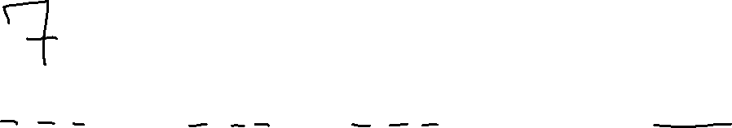
LeNet - 5
avg pool
avg pool
$$\hat{y}$$
5$×$ 5
s = 1
f = 2
s = 2
5$×$ 5
s = 1
f = 2
s = 2
$$⋮$$
$$⋮$$
32$×$32 $×$1
28$×$28$×$6
14$×$14$×$6
10$×$10$×$16
5$×$5$×$16
120
84
[LeCun et al., 1998. Gradient-based learning applied to document recognition]

Slide 5
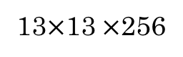
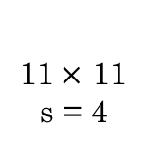
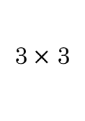

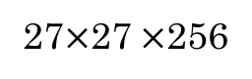
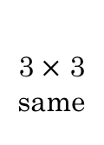

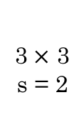
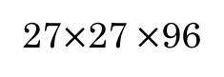
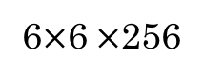
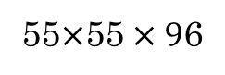
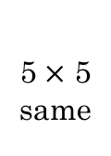
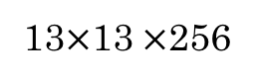
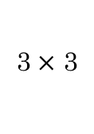
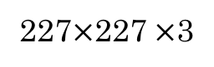
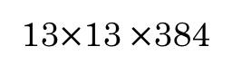
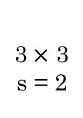
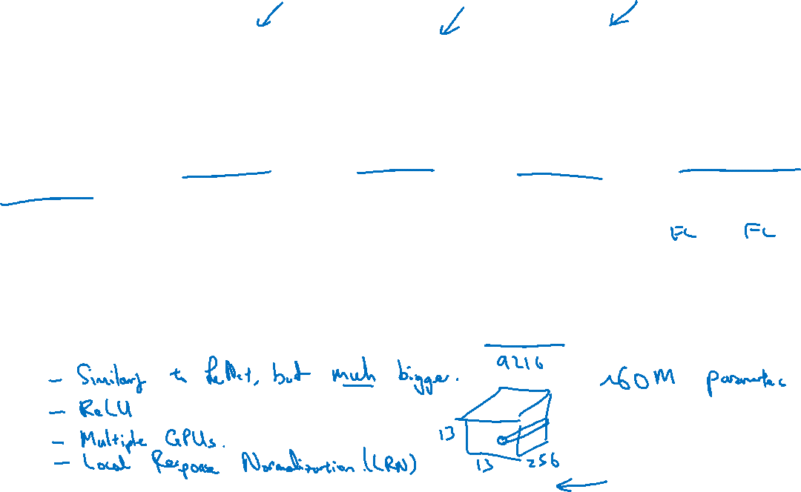
AlexNet
MAX-POOL
MAX-POOL
11$×$ 11
s = 4
3$×$ 3
s = 2
5$×$ 5
same
3$×$ 3
s = 2
55$×$55 $×9$6
27$×$27 $×$96
27$×$27 $×$256
13$×$13 $×$256
227$×$227 $×$3
MAX-POOL
=
3$×$ 3
same
3$×$ 3
3$×$ 3
3$×$ 3
s = 2
$$⋮$$
$$⋮$$
$$⋮$$
Softmax
1000
13$×$13 $×$384
13$×$13 $×$384
13$×$13 $×$256
6$×$6 $×$256
9216
4096
4096
[Krizhevsky et al., 2012. ImageNet classification with deep convolutional neural networks]

Slide 6
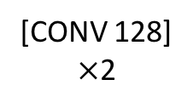
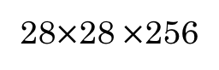
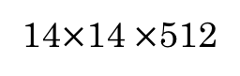
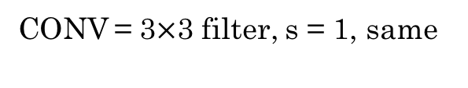
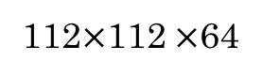
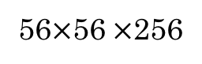
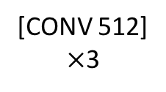
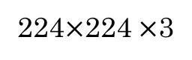
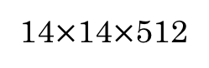
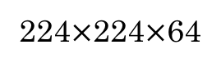
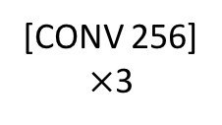
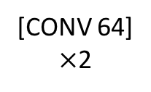
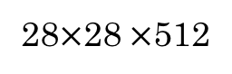
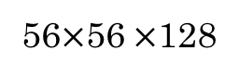
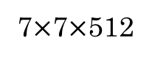
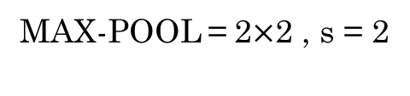
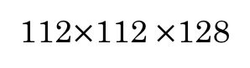
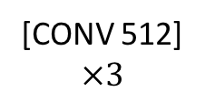
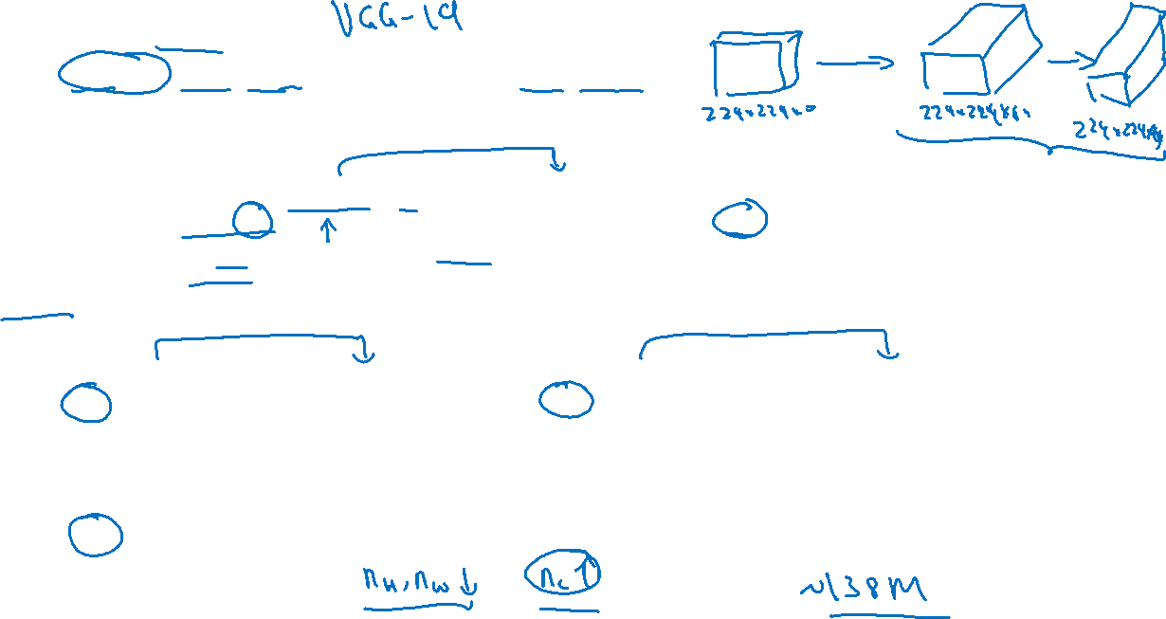
VGG - 16
CONV = 3$×$3 filter, s = 1, same
MAX-POOL = 2$×$2 , s = 2
224$×$224$×$64
112$×$112 $×$64
112$×$112 $×$128
56$×$56 $×$128
[CONV 64]
$×$2
POOL
[CONV 128]
$×$2
POOL
224$×$224 $×$3
56$×$56 $×$256
28$×$28 $×$256
28$×$28 $×$512
14$×$14$×$512
[CONV 256]
$×$3
POOL
[CONV 512]
$$×3$$
POOL
14$×$14 $×$512
7$×$7$×$512
FC
FC
Softmax
[CONV 512]
$×$3
POOL
4096
4096
1000
[Simonyan & Zisserman 2015. Very deep convolutional networks for large-scale image recognition]

Slide 7
Case Studies
Residual Networks (ResNets)
deeplearning.ai

Slide 8
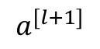
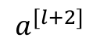
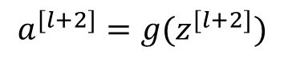
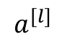




Residual block
$$a^{[l+1]}$$
$$a^{[l]}$$
$$a^{[l+2]}$$
$$z^{[l+1]}{=W}^{[l+1]}a^{[l]}+b^{[l+1]}$$
$$a^{[l+1]}=g(z^{[l+1]})$$
$$z^{[l+2]}= W^{[l+2]}a^{[l+1]}+b^{[l+2]}$$
$$a^{[l+2]}=g(z^{[l+2]})$$
[He et al., 2015. Deep residual networks for image recognition]

Slide 9



Residual Network
$$x$$
$$a^{[l]}$$
Plain
ResNet
training error
training error
# layers
# layers
[He et al., 2015. Deep residual networks for image recognition]

Slide 10
Case Studies
This page is not the official page because it hasn’t provided officially. Please contact me to update if provided. ACPrime@Github
Why ResNets
work
deeplearning.ai

Slide 11

Why do residual networks work?
This page is not the official page because it hasn’t provided officially. Please contact me to update if provided. ACPrime@Github

Slide 12

ResNet
This page is not the official page because it hasn’t provided officially. Please contact me to update if provided. ACPrime@Github
[He et al., 2015. Deep residual networks for image recognition]

Slide 13

Case Studies
Network in Network and 1$×$1 convolutions
deeplearning.ai

Slide 14










Why does a 1 $×$ 1 convolution do?
1 | 2 | 3 | 6 | 5 | 8
3 | 5 | 5 | 1 | 3 | 4
2 | 1 | 3 | 4 | 9 | 3
4 | 7 | 8 | 5 | 7 | 9
1 | 5 | 3 | 7 | 4 | 8
5 | 4 | 9 | 8 | 3 | 5
$$∗$$
2
$$=$$
6 $×$ 6
$$∗$$
$$=$$
6 $×$ 6 $×$ 32
1 $×$ 1 $×$ 32
6 $×$ 6 $×$ # filters
[Lin et al., 2013. Network in network]

Slide 15





Using 1$×$1 convolutions
ReLU
CONV 1 $×$ 1
32
28 $×$ 28 $×$ 32
28 $×$ 28 $×$ 192
[Lin et al., 2013. Network in network]

Slide 16
Case Studies
Inception network motivation
deeplearning.ai

Slide 17





Motivation for inception network
1 $×$ 1
3 $×$ 3
64
5 $×$ 5
128
28
32
32
28
28 $×$ 28 $×$ 192
MAX-POOL
[Szegedy et al. 2014. Going deeper with convolutions]
Note: the colors are intended to correspond to the stacked small hand drawn cube

Slide 18



The problem of computational cost
CONV
5 $×$ 5,
same,
32
28 $×$ 28 $×$ 32
28 $×$ 28 $×$ 192

Slide 19







Using 1$×$1 convolution
CONV
1 $×$ 1,
16,
1 $×$ 1 $×$ 192
CONV
5 $×$ 5,
32,
5 $×$ 5 $×$ 16
28 $×$ 28 $×$ 16
28 $×$ 28 $×$ 32
28 $×$ 28 $×$ 192

Slide 20
Case Studies
Inception network
deeplearning.ai

Slide 21









Inception module
1 $×$ 1 CONV
1 $×$ 1 CONV
3 $×$ 3 CONV
Previous Activation
Channel Concat
1 $×$ 1 CONV
5 $×$ 5 CONV
MAXPOOL 3 $×$ 3,s = 1 same
1 $×$ 1 CONV

Slide 22




Inception network
[Szegedy et al., 2014, Going Deeper with Convolutions]

Slide 23
http://knowyourmeme.com/memes/we-need-to-go-deeper

Slide 24
Practical advice for using ConvNets
This page is not the official page because it hasn’t provided officially. Please contact me to update if provided. ACPrime@Github
Using open-source implementations
deeplearning.ai

Slide 25
Practical advice for using ConvNets
This page is not the official page because it hasn’t provided officially. Please contact me to update if provided. ACPrime@Github
Transfer Learning
deeplearning.ai

Slide 26

Transfer Learning

Slide 27
Practical advice for using ConvNets
This page is not the official page because it hasn’t provided officially. Please contact me to update if provided. ACPrime@Github
Data augmentation
deeplearning.ai

Slide 28

Color shifting

Slide 29

Implementing distortions during training

Slide 30
Practical advice for using ConvNets
This page is not the official page because it hasn’t provided officially. Please contact me to update if provided. ACPrime@Github
The state of computer vision
deeplearning.ai

Slide 31

Data vs. hand-engineering

Slide 32
Tips for doing well on benchmarks/winning competitions

Slide 33

Tips for doing well on benchmarks/winning competitions

Slide 34
Use open source code
Use architectures of networks published in the literature
Use open source implementations if possible
Use pretrained models and fine-tune on your dataset

